Slide 1

EXECUTIVE SUMMARY
We have concluded the Total Cost of Ownership (TCO) analysis comparing running your IT services on-premise versus using Microsoft 365.
The analysis has been conducted using data that we have collected from your environment and using a TCO calculator fully transparent and easy to use.
You could save… if you move to Microsoft 365. In relative terms, this ….% of cost savings!!
The report will detail the methodology we followed, the data that we have collected and the results you could achieve.
Our recommendation going forward is to invest in Microsoft 365 to benefit from the immediate savings, improve on the overall productivity of your organization and make it future-proof which is essentials in today’s changing environments.

Slide 2
TCO ANALYSIS METHODOLOGY
The TCO analysis compares running the following IT services in your data center versus moving them to Microsoft 365:
Email Services, Users Personal Storage on File Server, Files on Share Drive Servers, Chat Application, Online Audio/Video Meetings, Anti-Virus, Single Sign-On and Device Management.
It also compares buying Microsoft licenses through Open Licensing Agreement versus subscribing to Microsoft 365.
For each of the services, we will look at:
Server | Annual Maintenance Cost
 | Technology Refresh Investment
 | Cooling Charges (% of Total Cooling Charges)
 | Electricity Charges (% of Total Electricity Charges)
Operating System - Server(s) License | Annual Maintenance Cost
 | Technology Refresh Investment
Software License | Annual Maintenance Cost
 | Technology Refresh Investment
Security Software | Anti-Virus Licenses
 | Anti-Spam Licenses
Archiving & Backup | Operating Cost
 | Technology Refresh Investment
Connectivity | Leased Line
 | Connectivity to Disaster Recovery Site
The TCO analysis also includes the costs of labor required to maintain the administer and upgrades the current systems versus deploying and migrating data to Microsoft 365.
The analysis is conducted over a period of 5 years to cater for at least one technology refresh investment.
All the data collected is then entered in a comparative Excel sheet adding all the costs together and comparing the total costs of running the systems in your data center (on-premise) versus moving to Microsoft 365.

Slide 3
DATA COLLECTED
The data that we will collect is the following:
Email Services | Server | Annual Maintenance Cost
 |  | Technology Refresh Investment
 |  | Cooling Charges (% of Total Cooling Charges)
 |  | Electricity Charges (% of Total Electricity Charges)
 | Operating System - Server(s) License | Annual Maintenance Cost
 |  | Technology Refresh Investment
 | Software License | Annual Maintenance Cost
 |  | Technology Refresh Investment
 | Security Software | Anti-Virus Licenses
 |  | Anti-Spam Licenses
 | Archiving & Backup | Operating Cost
 |  | Technology Refresh Investment
 | Connectivity | Leased Line
 |  | Connectivity to Disaster Recovery Site
Users Personal Storage on File Server | Server | Annual Maintenance Cost
 |  | Technology Refresh Investment
 |  | Cooling Charges (% of Total Cooling Charges)
 |  | Electricity Charges (% of Total Electricity Charges)
 | Operating System - Server(s) License | Annual Maintenance Cost
 |  | Technology Refresh Investment
 | Software License | Annual Maintenance Cost
 |  | Technology Refresh Investment
 | Security Software | Anti-Virus Licenses
 | Archiving & Backup | Operating Cost
 |  | Technology Refresh Investment
 | Licenses | Annual Maintenance Cost

Slide 4
3rd Party Application for file sharing and transferring | Licenses | Annual Maintenance Cost
 |  | Technology Refresh Investment
Files on Share Drive Servers | Server | Annual Maintenance Cost
 |  | Technology Refresh Investment
 |  | Cooling Charges (% of Total Cooling Charges)
 |  | Electricity Charges (% of Total Electricity Charges)
 | Operating System - Server(s) License | Annual Maintenance Cost
 |  | Technology Refresh Investment
 | Software License | Annual Maintenance Cost
 |  | Technology Refresh Investment
 | Security Software | Anti-Virus Licenses
 | Archiving & Backup | Operating Cost
 |  | Technology Refresh Investment
 | SharePoint Online Additional Storage | 1 TB + 10GB per user are included. For Additional Storage 0.2$/month for each additional 1GB
Hub for Teamwork | Chat Application | Annual Maintenance Cost
 |  | Technology Refresh Investment
 | Software to conduct Online Video Meetings | Annual Maintenance Cost
 |  | Technology Refresh Investment
 | Software to conduct Calls between Offices | Annual Maintenance Cost
 |  | Technology Refresh Investment
 | International calling bills (between Offices) | Annual Charges
Microsoft Licenses | Annual Licenses Costs | Bridge CAL
 |  | Microsoft Office Open Licenses
 |  | Microsoft Office Software Assurance
 |  | Office 365 Subscriptions
Anti-Virus | Server | Annual Maintenance Cost
 |  | Technology Refresh Investment
 |  | Cooling Charges (% of Total Cooling Charges)
 |  | Electricity Charges (% of Total Electricity Charges)
 | Operating System - Server(s) License | Annual Maintenance Cost
 |  | Technology Refresh Investment
 | Software License | Annual Maintenance Cost
 |  | Technology Refresh Investment
 | Archiving & Backup | Operating Cost
 |  | Technology Refresh Investment

Slide 5
 |  | Cooling Charges (% of Total Cooling Charges)
 |  | Electricity Charges (% of Total Electricity Charges)
 | Operating System - Server(s) License | Annual Maintenance Cost
 |  | Technology Refresh Investment
 | Software License | Annual Maintenance Cost
 |  | Technology Refresh Investment
 | Security Software | Anti-Virus Licenses
 | Archiving & Backup | Operating Cost
 |  | Technology Refresh Investment
Device Management | Server | Annual Maintenance Cost
 |  | Technology Refresh Investment
 |  | Cooling Charges (% of Total Cooling Charges)
 |  | Electricity Charges (% of Total Electricity Charges)
 | Operating System - Server(s) License | Annual Maintenance Cost
 |  | Technology Refresh Investment
 | Software License | Annual Maintenance Cost
 |  | Technology Refresh Investment
 | Security Software | Anti-Virus Licenses
 | Archiving & Backup | Operating Cost
 |  | Technology Refresh Investment
SERVICES | Annual Costs | Administration
 |  | Upgrades
 |  | Deployment and Migration

Slide 6
DATA COLLECTED

Slide 7

TCO ANALYSIS SUMMARY

Slide 8


Slide 9


Slide 10
RECOMMENDATIONS GOING FORWARD
Given that the TCO Analysis is showing clear evidence that moving to Microsoft 365 reduces your costs of delivering the IT services mentioned above and given that Microsoft 365 brings immense improvements to the productivity of your team, our recommendation is to receive a full proposal for the same including the cost of the subscriptions as well as the professional services required for the deployment and migration of data.
The proposal must be comprehensive to include all the costs that could be incurred such as 3rd party migration tools and additional storage (if required).
Other than the deployment services, end-users adoption services are recommended too for a successful deployment and making the most of your investment in Microsoft 365.

Slide 11

WHAT IS MICROSOFT 365
Microsoft 365 Enterprise
Office 365 Enterprise
Chat- centric workspace
Email & Calendar
Voice, Video & Meetings
Office applications/ co-authoring
Sites & Content Management
Analytics
Advanced Security & Compliance
Enterprise Mobility+ Security
Identity & Access Management
Managed Mobile Productivity
Information Protection
Identity Driven Security
Windows 10 Enterprise
Advanced Endpoint Security
Designed For Modern IT
More Productive
Powerful, Modern devices
A complete, intelligent, secure solution to empower employees
Unlocks creativity
Built for teamwork
Integrated for simplicity
Intelligent security

Slide 12


Unlocks creativity
Work naturally with ink, voice and touch
Visualize information in new ways
Create compelling content with intelligent apps
Build on the work and expertise of others
Built for teamwork
Enterprise-class email, voice and video
Connect everyone with company-wide communities
Share and collaborate on documents in real time
Includes Microsoft Teams, the new chat-based workspace

Slide 13
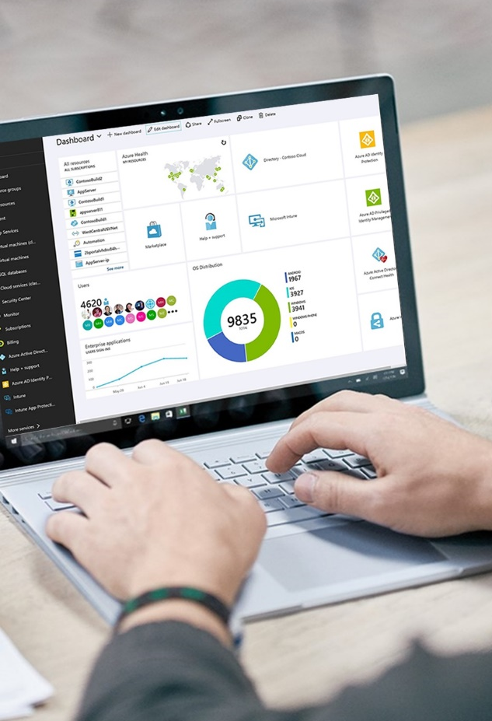
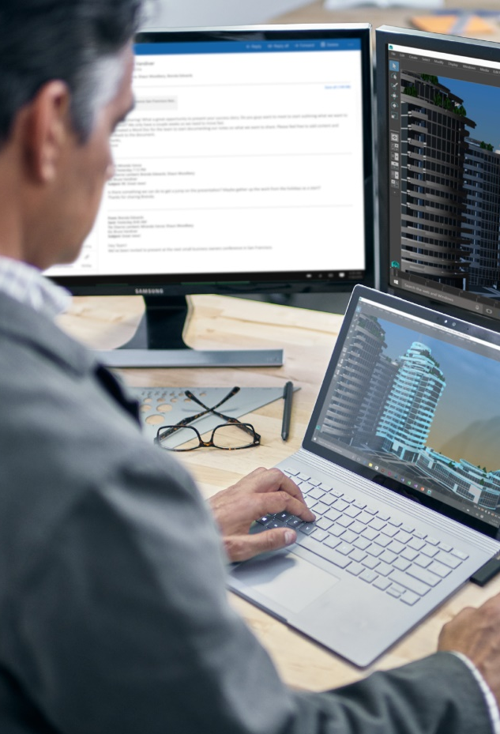
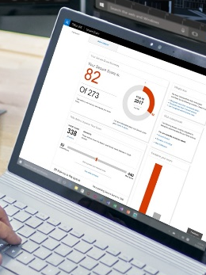
Integrated for simplicity
Always up-to-date
Self-service deployment
Cloud-based management
Rich telemetry from your environment
Reduce TCO with consolidated solutions
Intelligent security
Protect identity, apps, data & devices
Thwart advanced threats
Manage data archiving, governance & discovery
Powered by Microsoft Intelligent Security Graph
Accelerate GDPR compliance

